Slide 1

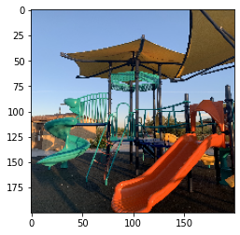
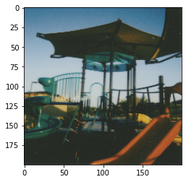
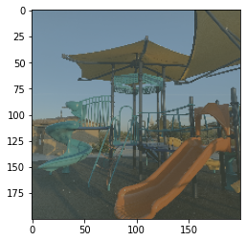
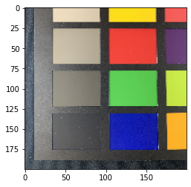
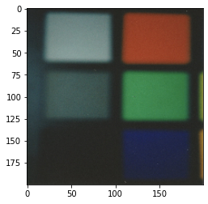
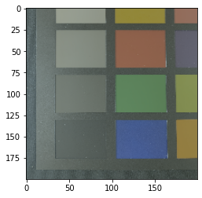
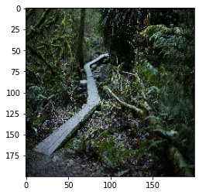
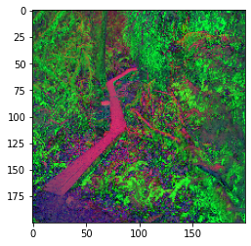
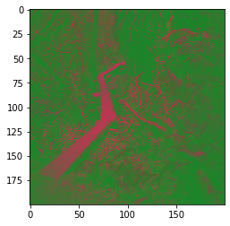
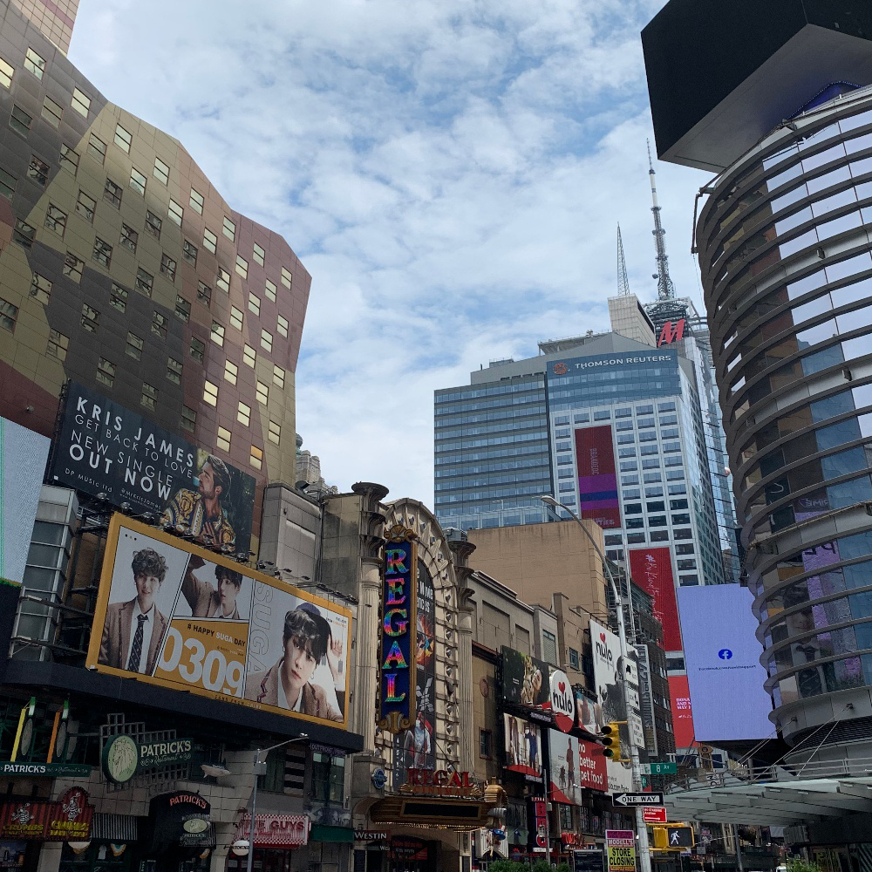
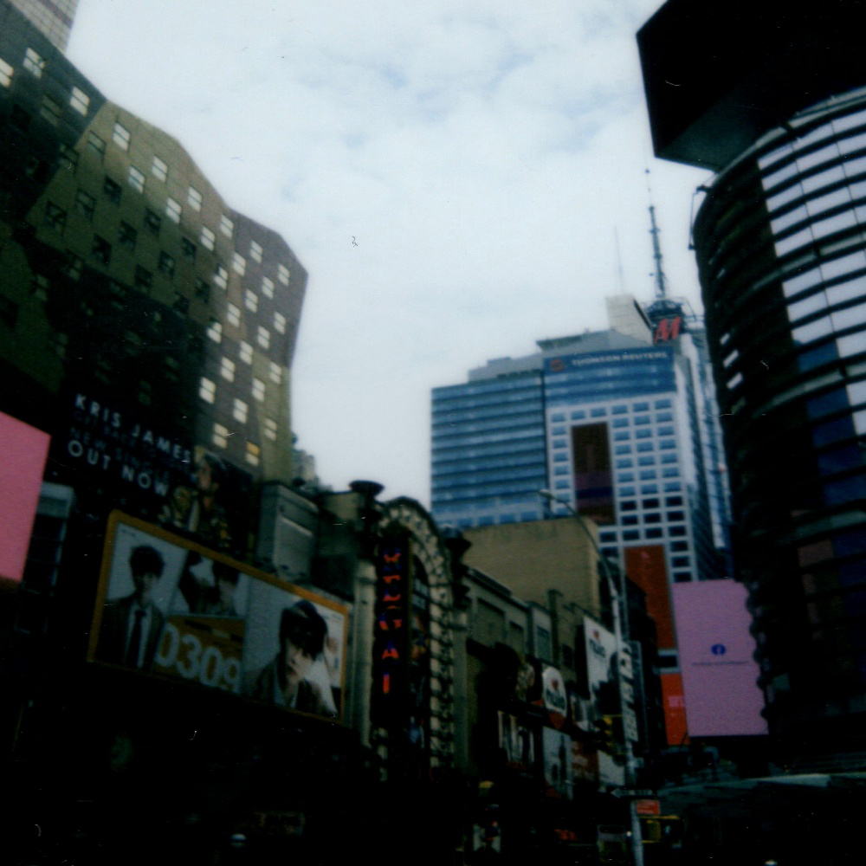
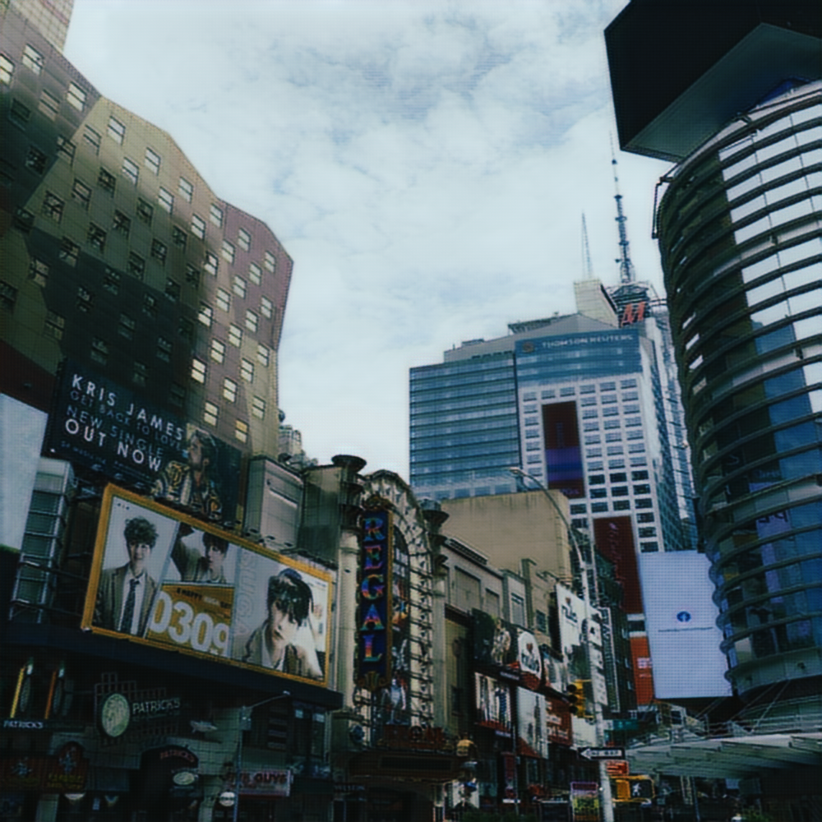
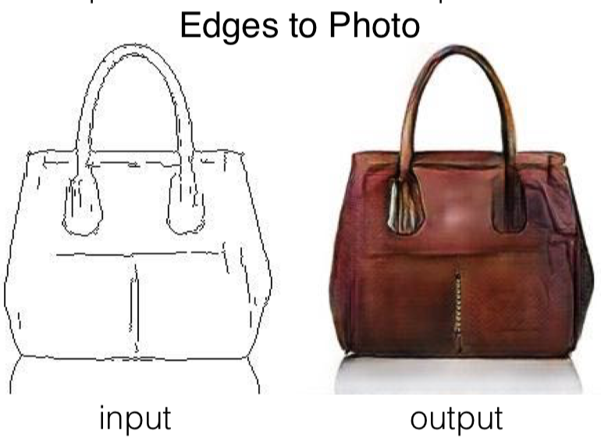
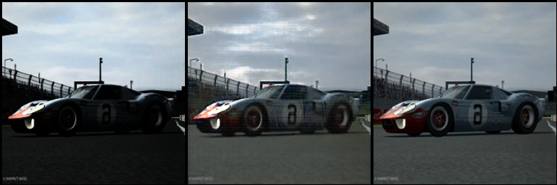
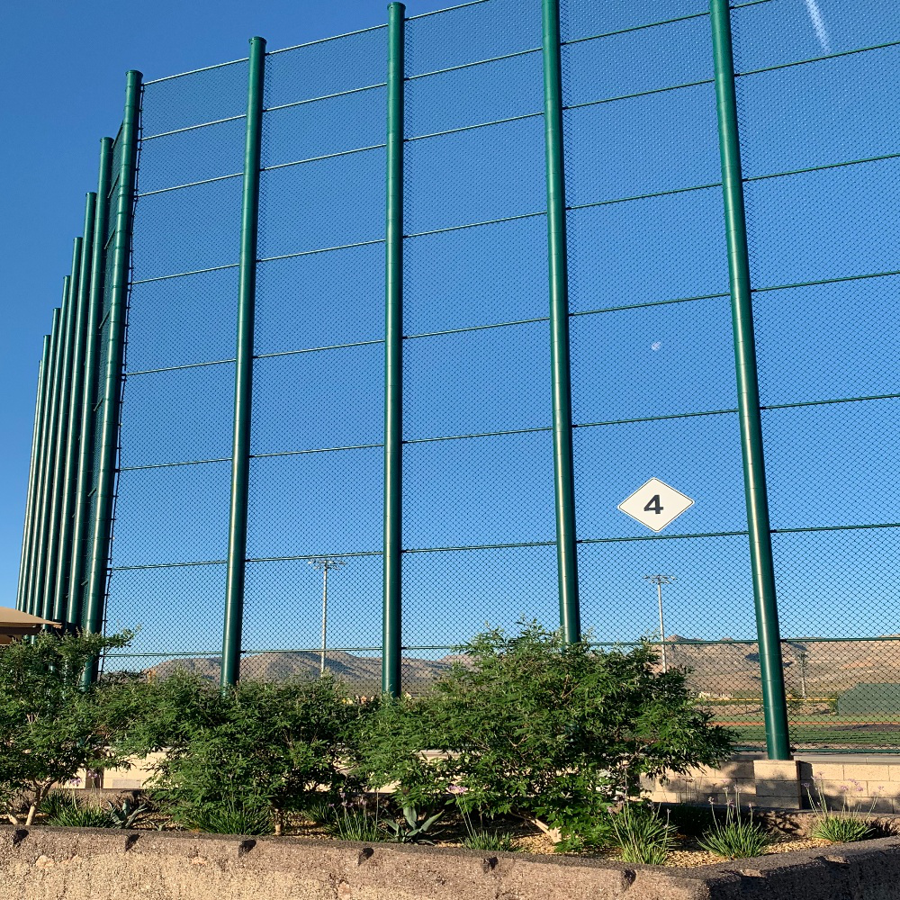
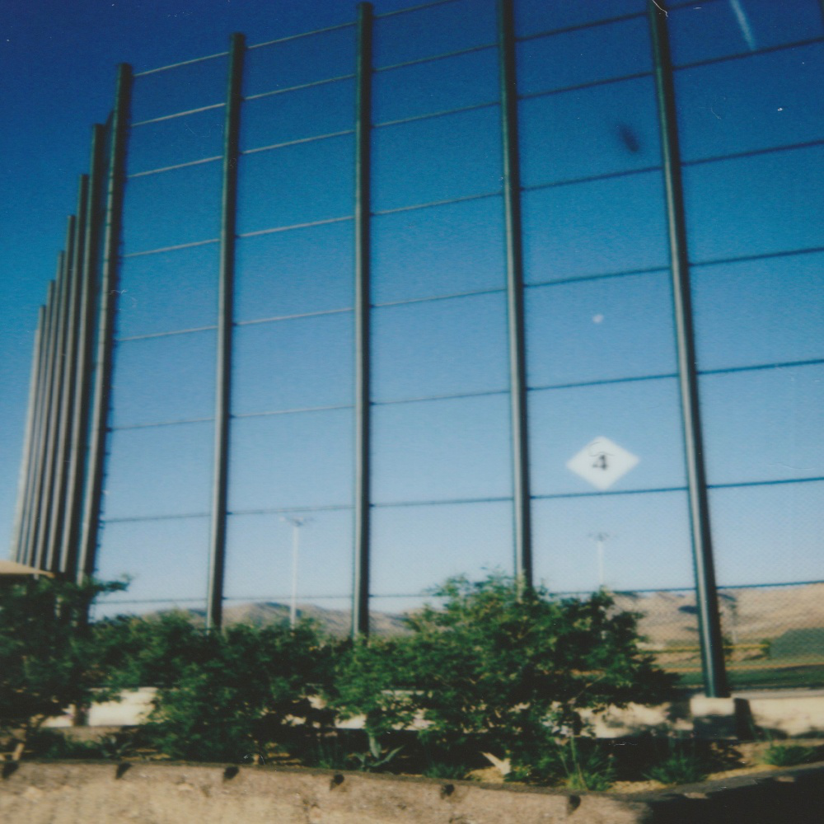
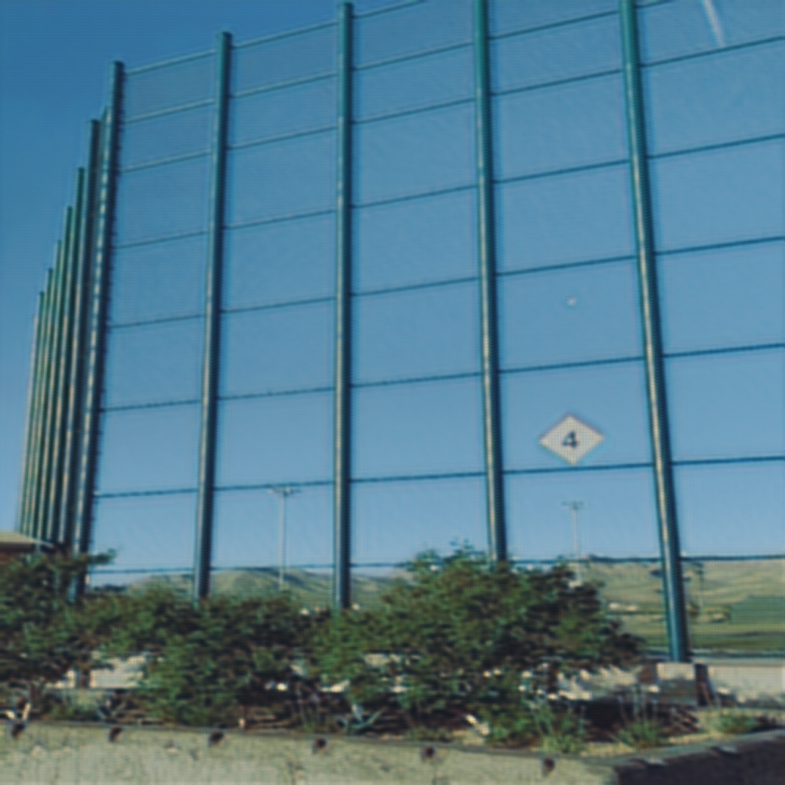
Using Machine Learning to Process Filters and Mimic Instant Camera Effect
Deirdre Chong, Undergraduate Student, Computer Science
Hassan Adam, Undergraduate Student, Computer Engineering
Jorge Fonseca Cacho, Ph.D., Professor, Department of Computer Science
University of Nevada Las Vegas
Introduction
Methods
Results
Findings
Machine Learning has seen a massive demand in computer applications over the past few years. From self-driving cars to predicting the future, Machine Learning makes it possible for computers to solve problems more quickly and efficiently than humans can [1]. Our research aims to apply machine learning in image processing. The potential of Machine Learning in image processing is limitless[2]. Machine Learning can be implemented in image processing in various ways, including photo enhancement [3]. Image-to-image translation has been implemented in intriguing ways, such as converting a stock photo to a canvas mimicking Van Gogh and Monet [1]. This research aims to apply Machine Learning to develop a model that will convert a standard unprocessed photo into a photo that visually looks as if it was taken with an instant camera, Leica Sofort. This camera has a unique look that many people know as the ‘Polaroid’ Look. See Figure 3. There are pre-existing Image filters that replicate Instant Camera Images, but none accurately capture all the differences and subtleties[4]. Image filters made with Machine Learning can replace outdated image processing approaches and lead us with endless image processing possibilities with the right training data set[5].
Machine Learning requires enough data to teach the computer how to convert the given input into the desired output. The dataset is split into two parts: one that contains normal images and ones that contain our desired output. The more examples we have, the better it can detect subtle unexplainable patterns.
As our initial method, we mined images from Bing and experimented with the images as our dataset. Then, we edited the images by introducing contrast and color changes and altered them into different styles using image processing tools like imageMagik and OpenCV. Next, we fed the images to the machine learning models to see how much data was necessary before it found the specific edits we did. This step was necessary to reduce film cost by estimating the minimum number of images required for the Machine Learning algorithm to produce useful outputs. After we found the optimal number of images, we collected polaroid images and digital images and matched the pixels using Adobe Photoshop.
Finally we used our polaroid dataset on machine learning models like Linear Regression, GANs (Generative Adversarial Networks) such as Cycle-GANs, and Pix2Pix GANss.
The trial run with digitally edited images resulted in successful prediction in Linear Regression around 800 - 1000 images. Machine learning model like Pix2Pix predicted the edited styles around 400 images.
Since polaroid film was scarce and expensive, we use around 150 Instant Camera Images with a corresponding Digital Image. The images are then fitted through the Linear Regression Model.
Figure 4 shows the prediction using linear regression using digital image and polaroid image datasets. The results alters the color to appear duller which slightly mimics the polaroid image as shown in figure 5.
Then we used Generative Adversarial Networks (GANs) on the same dataset and compared the results. We used the Pix2Pix GAN and CycleGAN on the 150 Instant Camera Images. Figure 6 shows the image prediction using Pix2Pix GAN. Figure 7 shows the image prediction using CycleGAN.
Our findings predicts accurate results with 400 images on our edited datasets. Our datasets with 150 Instant Camera Images showed promising results with Linear Regression and Generative Adversarial Networks. We predict that a dataset with 400 Instant Camera Images however such will be expensive and timely to make. Generative adversarial networks works better in predicting and finding the right mapping. Linear Regression is very limited and Generative Adversarial Network can pick up more efficient mappings by training a loss function. Our research found that General Adversarial Network predicts colors with a much higher accuracy and about 400 – 500 images are necessary to create accurate results.
Digital Image
Polaroid image
Predicted Image
Conclusion
Machine learning has a lot of potential applications in image processing. Our research found accurate results with Generative Adversarial Networks like Pix2Pix and CycleGAN. Our research showed that Machine learning can be implemented to create better image processing solutions. Machine learning can find new ways to mimic subtle differences and create a new approach to image processing[5].
The size of our datasets limited the results of our research. Our research dataset only contained 150 images due to the difficulty of taking pictures using a polaroid and scanning them in a high amount. By using more images, we anticipate an increase in the accuracy of the machine learning models. Other machine learning models also have yet to be tested to conclude the best model for this effect. The research concludes the use of machine learning in image processing. There is a lot of potential using machine learning to create new filters and image effects. We can experiment with our datasets and create cooler effects. Other aspects of photos can also increase accuracy, such as brightness, contrast, grain, etc. Even though our experiment was limited, we can see a promising result. The result of our Linear Regression model showed cool alterations of the colors used while Generative Adversarial Networks replicated the polaroid effect very well. Another machine learning approach might be capable of better results. Further experimentation is required to improve the accuracy of our results.
Figure 4: Linear Regression on polaroid dataset
Background
Test Results
Common Image to image translation uses pixels to pixels models to predict the corresponding translation.
They can be implemented with algorithms such as linear regression. For linear regression models we will be parsing each of the RGB values per pixel of the paired image data sets.
Ry_{i} = rx_{0i} + gx_{1i}+ bx_{2i} + y
Gy_{i} = rx_{0j} + gx_{1j} + bx_{2j} + y
By_{i} = rx_{0k} + gx_{1k} + bx_{2k} + y
Better Image-to-Image translation solutions can be seen using conditional adversarial networks as seen on the paper. Conditional adversarial networks efficiently learns the mapping and learns a loss function to train the model [6].
Previous Image-to-Image translation research such as
Pix2Pix aims to solve the same problem of translating an input image into its corresponding output. On figure 1, Pix2Pix uses machine learning to turn sketch into a product image. Pix2Pix successfully translates a sketch to a realistic photo.
As our initial test we applied linear regression to predict images on our test datasets. The paired images are resized to the same resolution and then RGB values are extracted from the image. Then this values are then fitted through linear regression. Figure 2 shows the sample images and the result using linear regression and used around 800 training images.
Original Image
Edited image
Predicted Image
Figure 5: Color comparison between original, polaroid, and predicted dataset
Digital Image
Polaroid image
Predicted Image
Figure 2: Linear regression on test sample side by side comparison
The next step on our test is to use Pix2Pix Generative Adversarial Networks (GANs) on our test dataset. The contrast is edited using imageMagik and used as the original image. The model seemed to do a pretty good job recovering back details that was lost when the contrast was heightened. Figure 3 shows the results of the model after 50 epochs trained with 400 paired images.
References
[1] https://www.ocf.berkeley.edu/~djhoward/reports/Report%20-%20Public%20Perceptions%20of%20Self%20Driving%20Cars.pdf
[2]https://towardsdatascience.com/image-recognition-with-machine-learning-on-python-image-processing-3abe6b158e9a
[3]https://arxiv.org/pdf/1703.10593v6.pdf
[4]https://apps.apple.com/us/app/instalab-instant-films/id1113395996
[5]https://research.utwente.nl/files/6039479/luukspreeuwers_phdthesis.pdf
[6] https://arxiv.org/pdf/1611.07004v1.pdf
Figure 6: Pix2Pix GAN on polaroid dataset
Figure 1: Pix2Pix outline to product photo
Edited Image
Predicted Image
Desired Output
Digital Image
Polaroid image
Predicted Image
Figure 3: GANs on contrast test dataset
Figure 7: CycleGAN on polaroid dataset

